Slide 1
K-Nearest Neighbor(KNN)

Slide 2
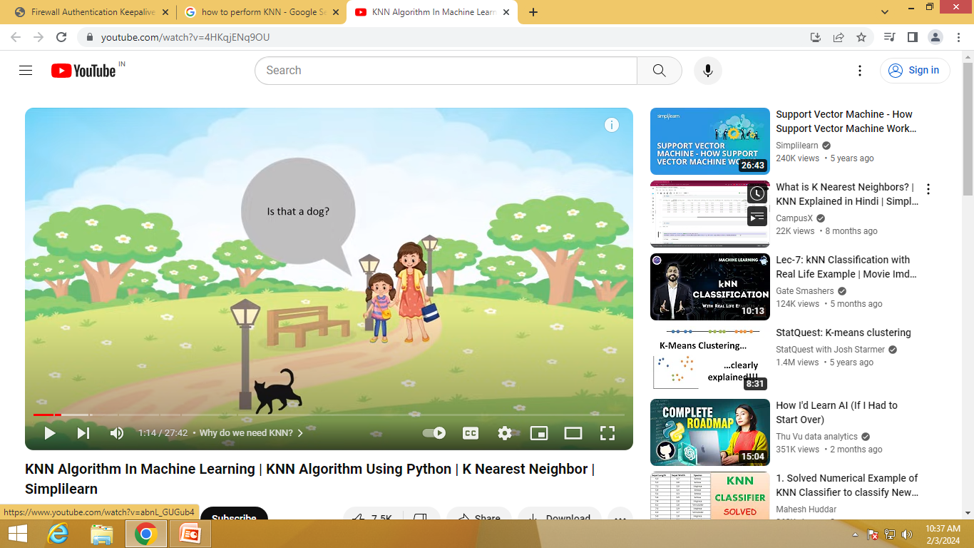
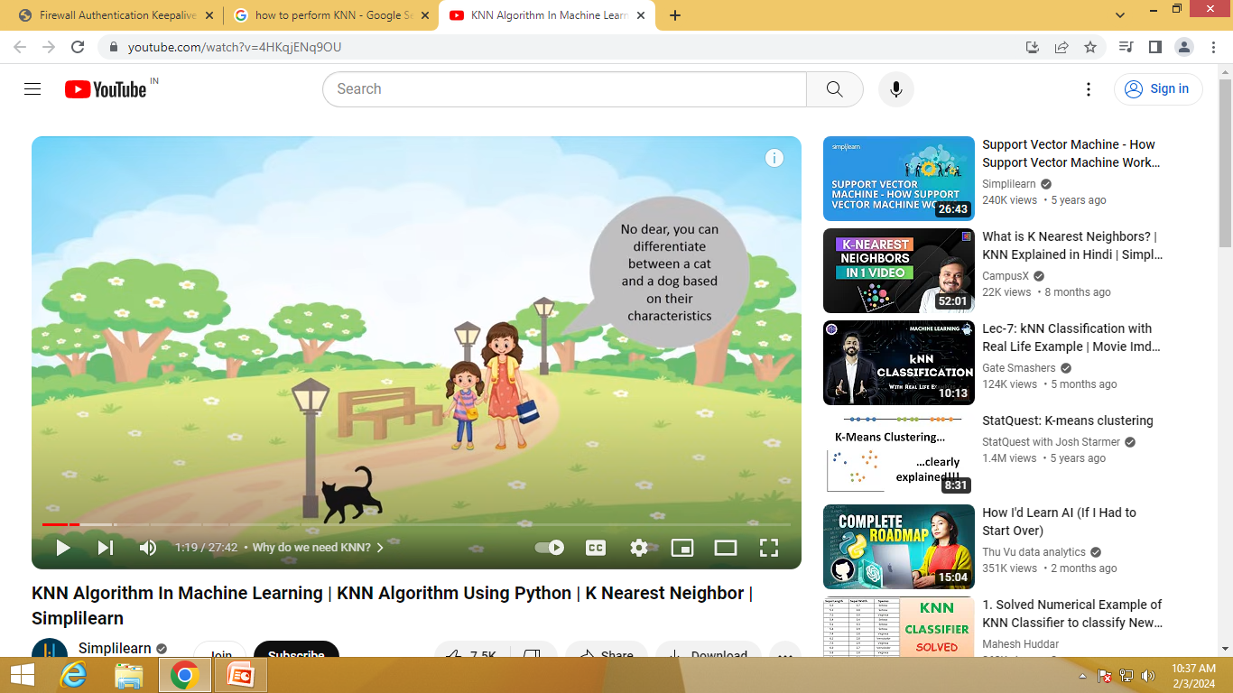
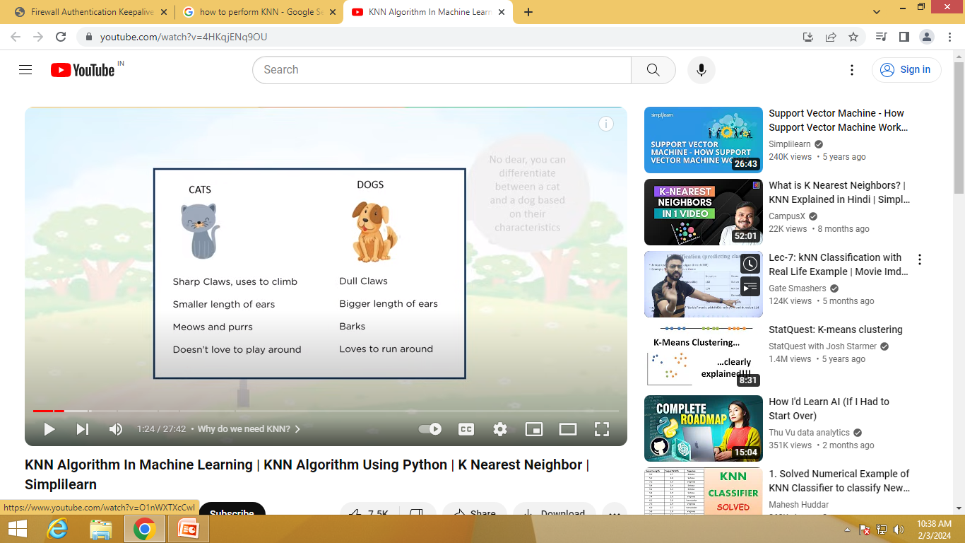
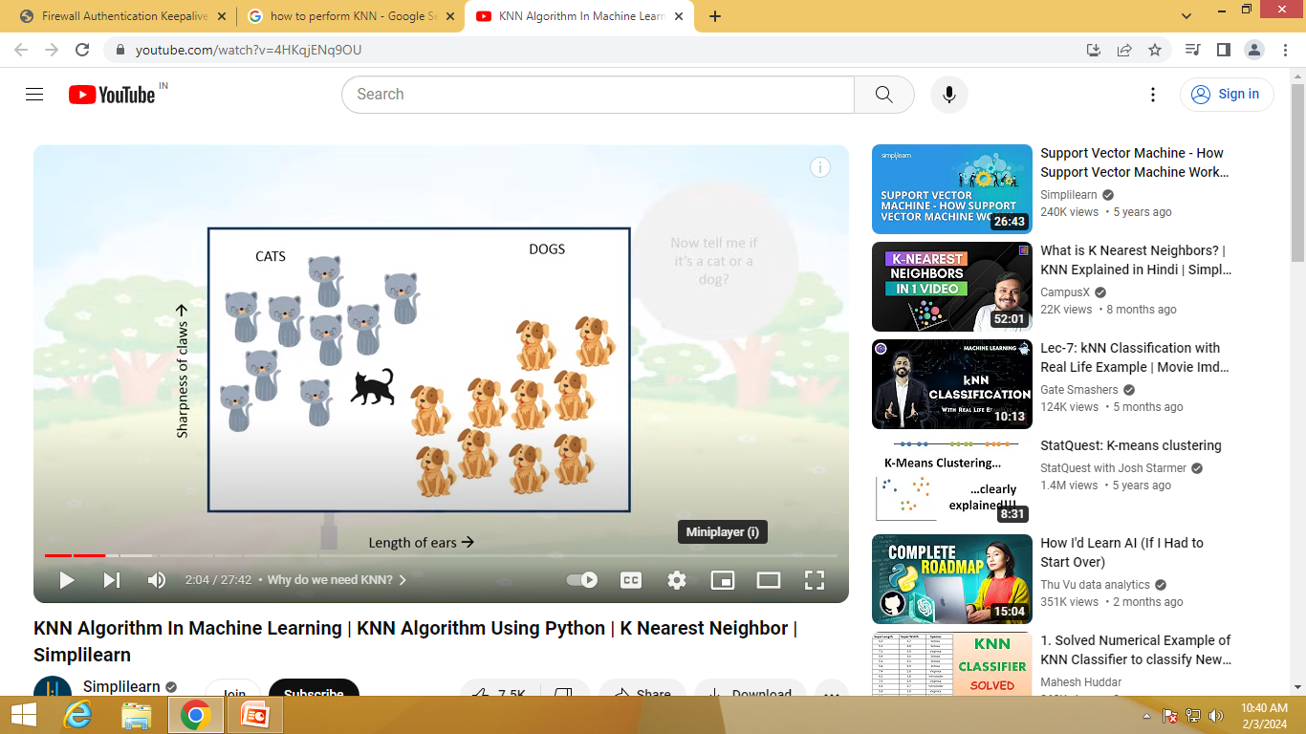

Slide 3
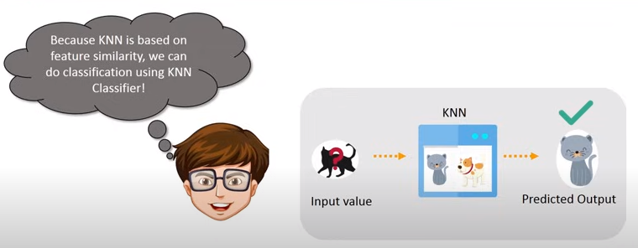

Slide 4
K-Nearest Neighbor(KNN)
K-Nearest Neighbour is one of the simplest Machine Learning algorithms based on Supervised Learning technique.
K-NN algorithm assumes the similarity between the new case/data and available cases and put the new case into the category that is most similar to the available categories.
K-NN algorithm stores all the available data and classifies a new data point based on the similarity. This means when new data appears then it can be easily classified into a well suite category by using K- NN algorithm.

Slide 5
K-Nearest Neighbor(KNN)
K-NN algorithm can be used for Regression as well as for Classification but mostly it is used for the Classification problems.
K-NN is a non-parametric algorithm, which means it does not make any assumption on underlying data.
It is also called a lazy learner algorithm because it does not learn from the training set immediately instead it stores the dataset and at the time of classification, it performs an action on the dataset.
KNN algorithm at the training phase just stores the dataset and when it gets new data, then it classifies that data into a category that is much similar to the new data.

Slide 6
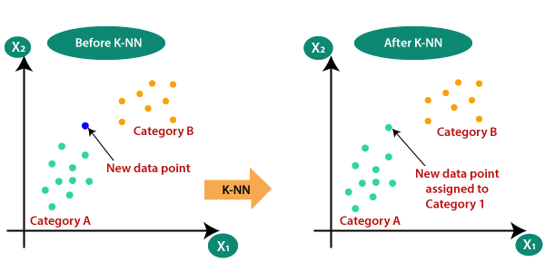

Slide 7
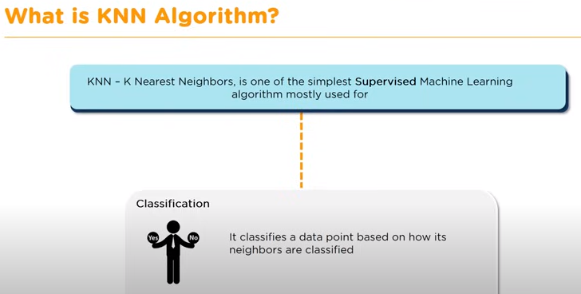

Slide 8
Working of KNN
The K-NN working can be explained on the basis of the below algorithm:
Step 1: Selecting the optimal value of K
K represents the number of nearest neighbors that needs to be considered while making prediction.
Step 2: Calculating distance
To measure the similarity between target and training data points, Euclidean distance is used. Distance is calculated between each of the data points in the dataset and target point.

Slide 9
Working of KNN
Step 3: Finding Nearest Neighbors
The k data points with the smallest distances to the target point are the nearest neighbors.
Step 4: Voting for Classification or Taking Average for Regression
In the classification problem, the class labels of are determined by performing majority voting. The class with the most occurrences among the neighbors becomes the predicted class for the target data point.
In the regression problem, the class label is calculated by taking average of the target values of K nearest neighbors. The calculated average value becomes the predicted output for the target data point.

Slide 10
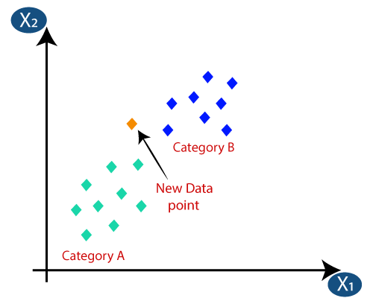
How does KNN Work?
Suppose we have a new data point and we need to put it in the required category. Consider the below image:

Slide 11
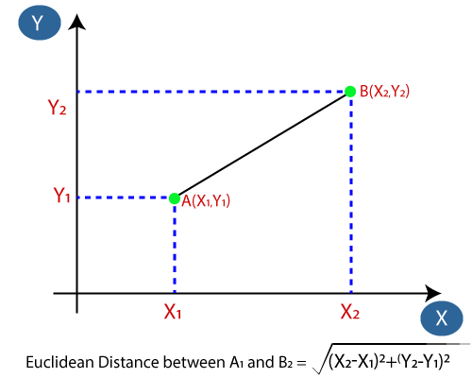
How does KNN Work?
Firstly, we will choose the number of neighbors, so we will choose the k=5.
Next, we will calculate the Euclidean distance between the data points. The Euclidean distance is the distance between two points, which we have already studied in geometry. It can be calculated as:

Slide 12
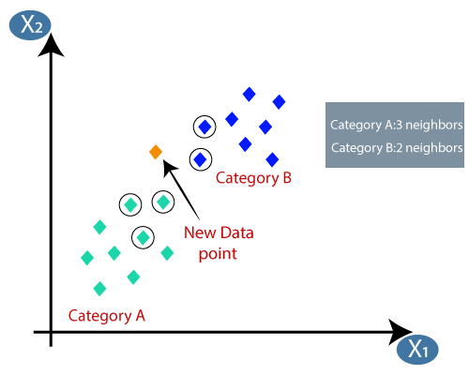
How does KNN Work?
By calculating the Euclidean distance we got the nearest neighbors, as five nearest neighbors in category A and two nearest neighbors in category B. Consider the below image:
As we can see the 3 nearest neighbors are from category A, hence this new data point must belong to category A.

Slide 13
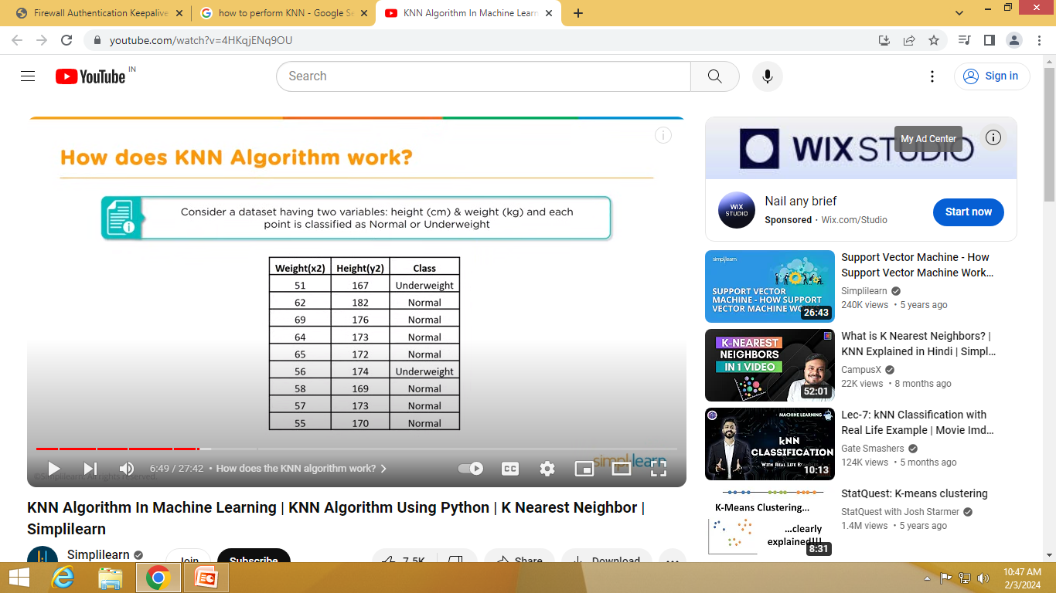

Slide 14
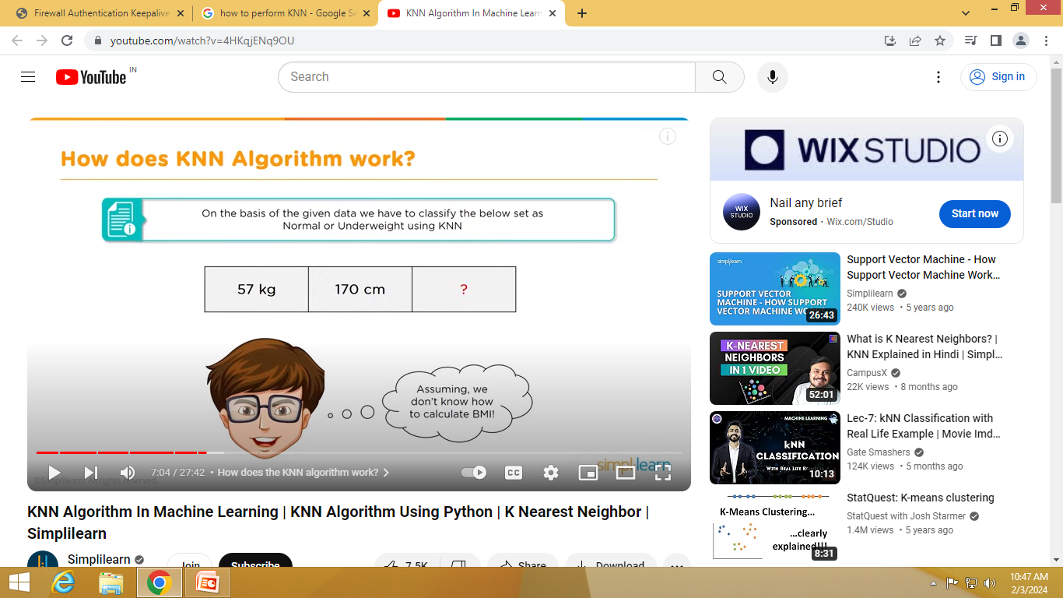

Slide 15
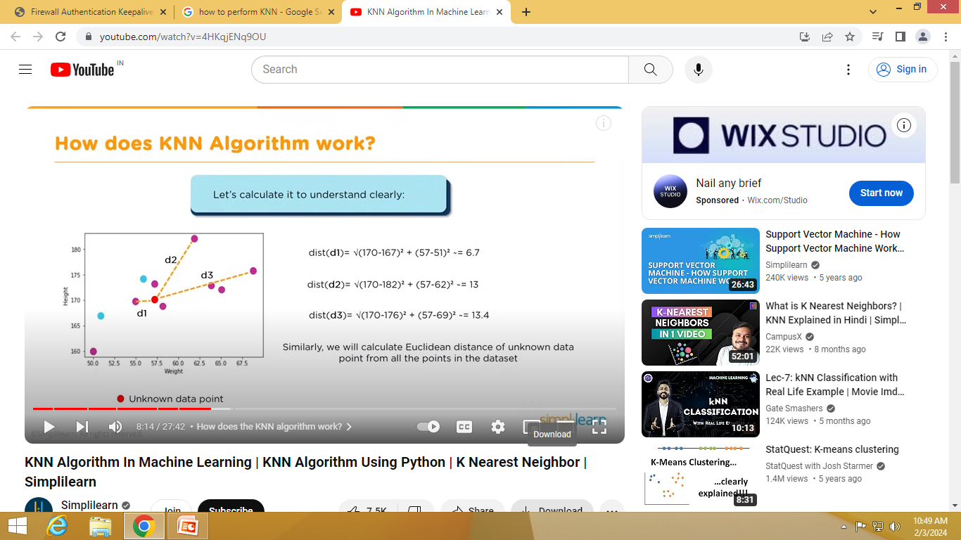

Slide 16
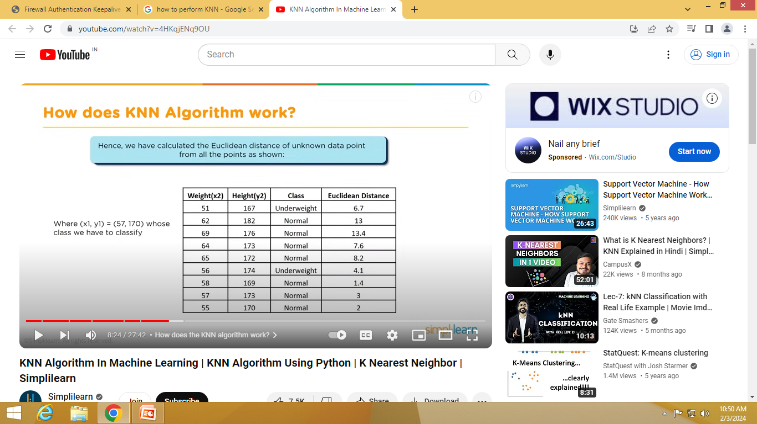

Slide 17
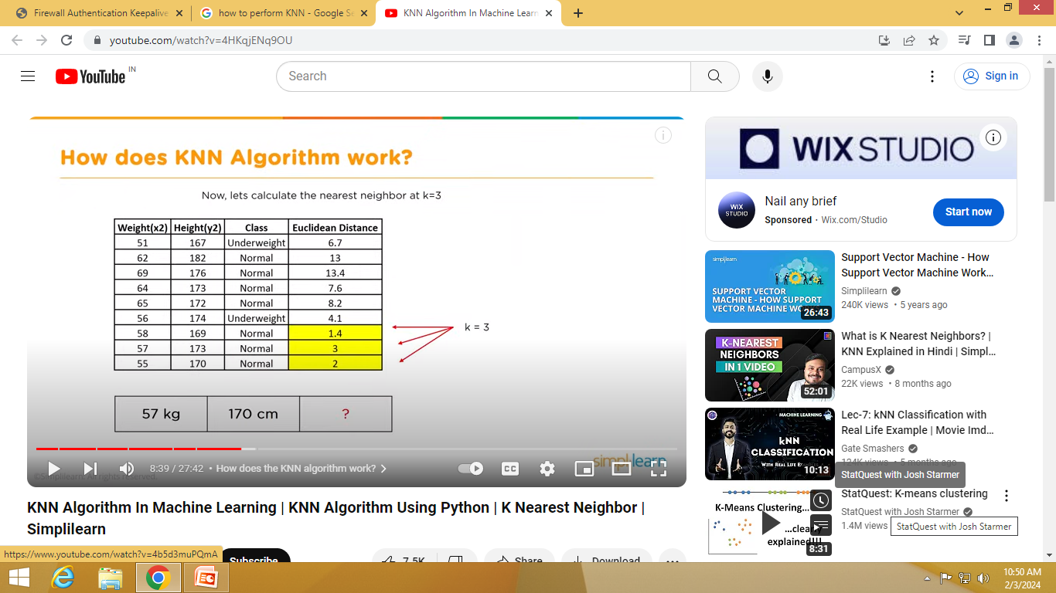

Slide 18
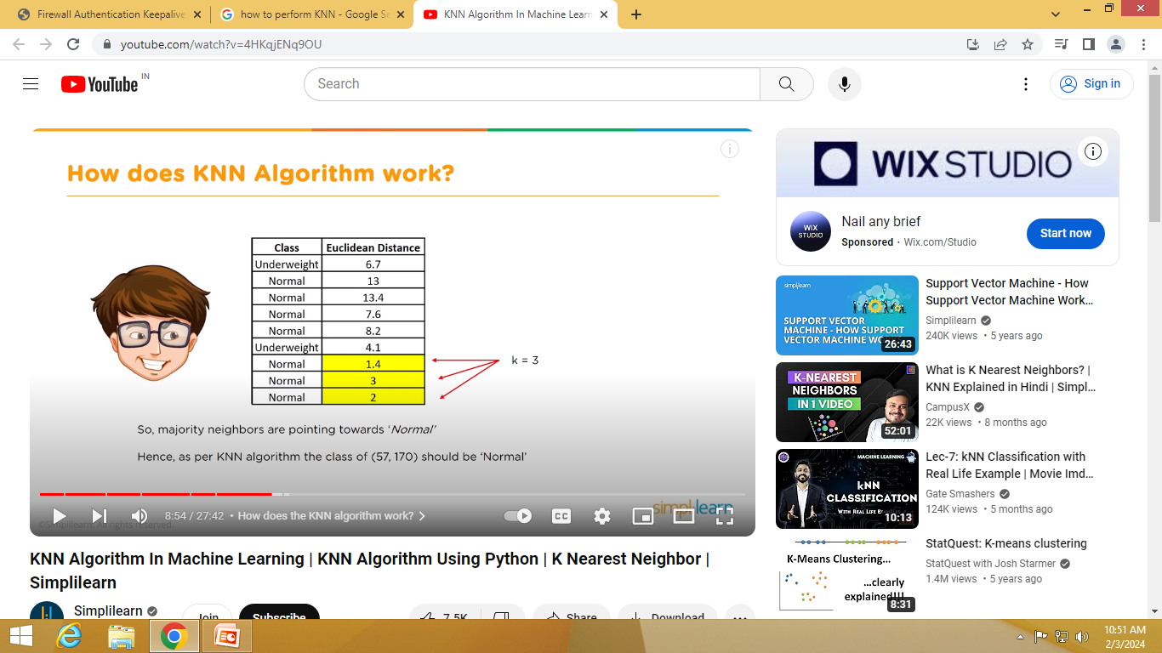

Slide 19
How to select the value of K in the K-NN Algorithm?
There is no particular way to determine the best value for "K", so we need to try some values to find the best out of them. The most preferred value for K is 5.
A very low value for K such as K=1 or K=2, can be noisy and lead to the effects of outliers in the model.
Large values for K are good, but it may find some difficulties.

Slide 20
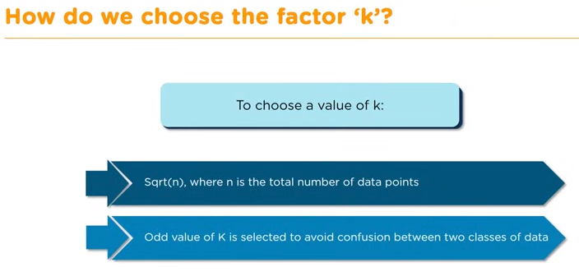

Slide 21
Advantages of KNN Algorithm:
It is simple to implement.
It is robust to the noisy training data
It can be more effective if the training data is large.

Slide 22
Disadvantages of KNN Algorithm:
Always needs to determine the value of K which may be complex some time.
The computation cost is high because of calculating the distance between the data points for all the training samples.
KNN algorithm is affected by the curse of dimensionality which implies the algorithm faces a hard time classifying the data points properly when the dimensionality is too high.

Slide 23
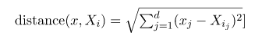
Distance Metrics Used in KNN Algorithm
Euclidean Distance
This is nothing but the cartesian distance between the two points which are in the plane/hyperplane. Euclidean distance can also be visualized as the length of the straight line that joins the two points which are into consideration. This metric helps us calculate the net displacement done between the two states of an object.

Slide 24
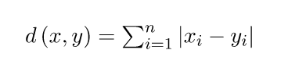
Distance Metrics Used in KNN Algorithm
Manhattan Distance
Manhattan Distance metric is generally used when we are interested in the total distance traveled by the object instead of the displacement. This metric is calculated by summing the absolute difference between the coordinates of the points in n-dimensions.

Slide 25
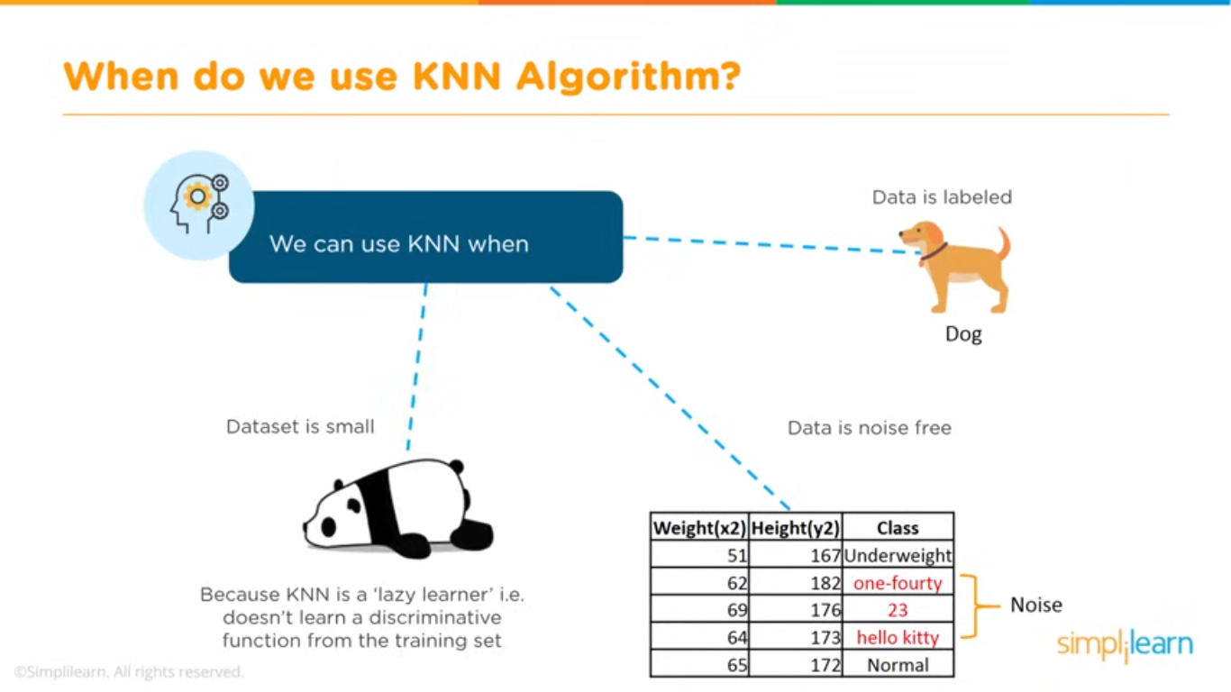

Slide 26
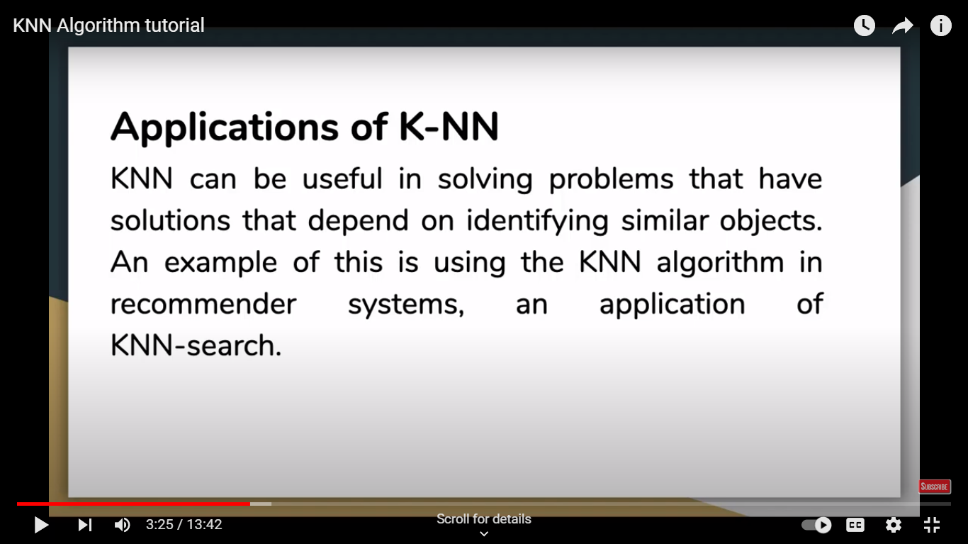
Application of KNN

Slide 27
Reference
https://www.youtube.com/watch?v=4HKqjENq9OU

